Slide 1
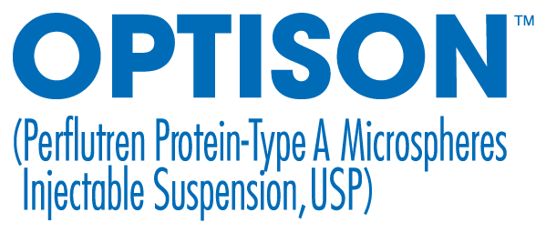
EdGE
An educational initiative from GE HealthCare
Optison overview presentation
Prior to Optison administration, please see Important Safety Information, including Boxed Warning, on the following slide, and read the Full Prescribing Information provided to you at the beginning of this session.
Optison is a trademark of GE HealthCare.
Notes:
[Note: this EdGE deck is geared to prospects who don’t use UEAs, low volume Optison users, and prospects who use competitor products. It is not geared for high volume users of Optison.]
[Note: Be sure to distribute the PI to attendees before beginning presentation.]
Today I would like to talk with you about Optison, an ultrasound enhancing agent for echocardiography.
By now you should have received an electronic or print copy of the Optison prescribing information.

Slide 2
IMPORTANT SAFETY INFORMATION ABOUT OPTISON
Indications: OPTISON is an ultrasound contrast agent indicated for use in adult and pediatric patients with suboptimal echocardiogram to opacify to the left ventricle to improve the delineation of the left ventricle endocardial borders.
WARNING: SERIOUS CARDIOPULMONARY REACTIONS
Serious cardiopulmonary reactions, including fatalities, have occurred uncommonly during or following perflutren-containing microsphere administration. Most serious reactions occur within
30 minutes of administration
Assess all patients for the presence of any condition that precludes OPTISON administration
Always have resuscitation equipment and trained personnel readily available
CONTRAINDICATIONS: OPTISON is contraindicated in patients with known or suspected hypersensitivity to perflutren or albumin.
WARNINGS AND PRECAUTIONS:
Serious cardiopulmonary reactions including fatalities have occurred uncommonly during or shortly following perflutren-containing microsphere administration, typically within 30 minutes of administration. The risk for these reactions may be increased among patients with unstable cardio-pulmonary conditions (acute myocardial infarction, acute coronary artery syndromes, worsening or unstable congestive heart failure, or serious ventricular arrhythmias).
Serious anaphylactic reactions have been observed during or shortly following perflutren-containing microsphere administration, including shock, hypersensitivity, bronchospasm, throat tightness, angioedema, edema (pharyngeal, palatal, mouth, peripheral, localized), swelling
(face, eye, lip, tongue, upper airway), facial hypoesthesia, rash, urticaria, pruritus, flushing,
and erythema have occurred in patients with no prior exposure to perflutren-containing microsphere products.
When administering OPTISON to patients with a cardiac shunt, microspheres can bypass filtering of the lungs and enter the arterial circulation. Assess patients with shunts for embolic phenomena following OPTISON administration. OPTISON is only for intravenous administration; do not administer OPTISON by intra-arterial injection.
High ultrasound mechanical index values may cause microsphere rupture and lead to ventricular arrhythmias. Additionally, end-systolic triggering with high mechanical indices has been reported to cause ventricular arrhythmias OPTISON is not recommended for use at mechanical indices greater than 0.8.
ADVERSE REACTIONS
Common adverse reactions (incidence > 0.5%) were: headache, nausea and/or vomiting,
warm sensation or flushing, dizziness, dysgeusia, chills or fever, flu-like symptoms, malaise/weakness/fatigue, chest pain, dyspnea, injection site discomfort, and erythema. Cardiac arrests and other serious but nonfatal adverse reactions were uncommonly reported in post-approval use. Reports also identified neurologic reactions (loss of consciousness or convulsions) as well as anaphylactoid reactions. Overall, the safety profile observed in pediatric patients from the clinical study was consistent with the safety profile in adult patients.
Use in specific populations
Pregnancy and lactation
There are no data with OPTISON use in pregnant woman to inform any drug-associated risks.
There are no data on the presence of perflutren protein-type A microspheres in human milk, the effects on the breastfed infant or the effects on milk production.
Pediatric Use
Safety and efficacy of OPTISON in pediatric patient is supported by evidence from adequate and well-controlled studies in adults and additional efficacy and safety data from a clinical study in 37 pediatric patients aged 9-17 years.
Geriatric Use
No overall differences in safety or effectiveness were observed in patients 65 years and over but a greater sensitivity to OPTISON in older individuals cannot be ruled out.
Please see the full Prescribing Information, including Boxed Warning for additional important safety information.
To report SUSPECTED ADVERSE REACTIONS, contact GE HealthCare at 800 654 0118 (option 2 then option 1) or by email at GPV.drugsafety@gehealthcare.com or FDA at 800 FDA 1088 or www.fda.gov/medwatch.
Optison is a trademark of GE HealthCare.

Slide 3


Agenda
  Optison timeline
  Composition
  Mechanism of action
  Safety profile
  Image quality and case study
  Ultrasound enhancing agent (UEA) guidelines
  Efficiency
  Support
Please see additional Important Safety Information, including Boxed Warning, on slide 2, and Full Prescribing Information provided to you at the beginning of this presentation.
Optison is a trademark of GE HealthCare.
Notes:
[Read slide]

Slide 4
Timeline

Slide 5












Since 1997, over 5 million doses shipped worldwide¹
May 2008
November 2007
November 2005
April 2004
December 2002
May 1998
FDA revises Boxed Warning for ultrasound enhancing agents
January 1998
December 1997
Optison relaunched for US echocardiography market
GE HealthCare voluntarily recalled Optison due to manufacturing issues at Mallinckrodt
GE HealthCare acquires Amersham Health
Transfer of Optison from Mallinckrodt Pharmaceuticals to Amersham Health
Launched in the European market
Launched as the first second-generation ultrasound enhancing agent for the US market
September 2021
Approved by the FDA for ultrasound enhancing imaging in the US
July 2021
March 2021
September 2016
April 2016
January 2014
FDA removes blood and blood products hypersensitivity contraindication, further confirming Optison is not a blood product
December 2013
August 2012
Optison no longer requires temperature-controlled shipping, through should be refrigerated upon receipt
FDA approves storage at room temperature up to 24 hours
FDA removes cardiac shunt contraindication
New 18-vial carton
GE HealthCare moves manufacturing to company’s Oslo site
1.5 million doses shipped worldwide in 15 years
Positive updates to Optison label approved by the FDA
Reference: 1. Data on file. GE HealthCare; 2025.
Optison is a trademark of GE HealthCare.
Notes:
Optison has been on the market for 25 years—in fact, it was the first of the second-generation ultrasound enhancing agents for the US.
Since 1997, over 3 million doses have shipped worldwide with the vast majority of them in the US.
GE Healthcare has invested in improvements to ensure the quality of the product and consistent supply to customers over the years.
The FDA approved a number of positive updates to the Optison label including being the first to remove the cardiac shunt contraindication, approving storage at room temperature up to 24 hours, and removing the blood and blood products contraindication, further confirming that Optison is not a blood product.

Slide 6
Composition
Notes:
Let’s discuss the composition of Optison.

Slide 7
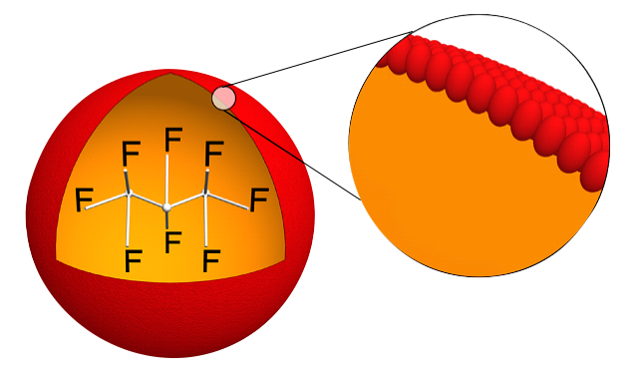
Microsphere components
Optison microsphere
Optison contains the stable gas perflutren encapsulated by a natural albumin shell¹⁻³
  Perflutren is eliminated through the lungs within
  10 minutes after injection
  Albumin is an abundant human protein expected to be handled by the normal metabolic routes
    Renal, gastrointestinal, and catabolic clearance processes⁴
Optison is the only ultrasound enhancing agent in the US with an albumin shell²
Albumin shell
Perflutren gas
Important Safety Information About Optison
Contraindications: OPTISON is contraindicated in patients with known or suspected hypersensitivity to perflutren or albumin.
Please see additional Important Safety Information, including Boxed Warning, on slide 2, and Full Prescribing Information provided to you at the beginning of this presentation.
References: 1. Optison [prescribing information]. Arlington Heights, IL: GE Healthcare; 2021. 2. Lindner J. A Practical Approach to Contrast Echocardiography, 2017. https://www.acc.org/latest-in-cardiology/articles/2017/07/10/09/17/a-practical-approach-to-contrast-echocardiography. Accessed September 2, 2022. 3. Quinlan GJ et al. Hepatology. 2005;41:1211-1219. 4. Levitt DG and Levitt MD. Int J Gen Med. 2016;9:229-255.
Optison is a trademark of GE HealthCare.
Notes:
Optison contains the stable gas perflutren encapsulated by an albumin shell, and it is the only ultrasound enhancing agent in the US with an albumin shell.
The perflutren gas is expelled through the lungs within 10 minutes of administration, and albumin is an abundant human protein expected to be handled by the normal metabolic routes of renal, gastrointestinal, and catabolic clearance processes.

Slide 8

Products containing albumin are used in many areas in hospitals
Ultrasound
Surgery
Oncology
Critical Care
Emergency Medicine
Nuclear Medicine
Neurology
NICU
Pediatrics and General Medicine
Data on file for each hospital area; GE HealthCare.
Optison is a trademark of GE HealthCare.
Notes:
Albumin is part of products used in many areas in hospitals, from nuclear medicine, to emergency medicine, surgery, pediatrics and general medicine, and of course, ultrasound as well.

Slide 9
Mechanism of action

Slide 10
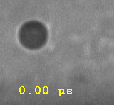
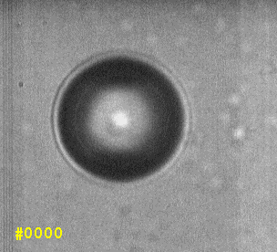
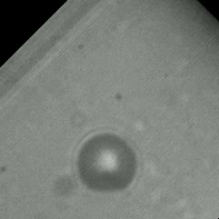
Acoustic response of microbubbles
100 KPa
300 KPa
450 KPa
  Microbubbles can compress and expand due to the pressure variation in the surrounding medium
  The vibration of microbubbles can largely increase the backscattered signal from blood, enhancing the image contrast
Please see Important Safety Information, including Boxed Warning, on slide 2, and Full Prescribing Information provided to you at the beginning of this presentation.
Reference: Bagley JE et al. J Diag Med Sono. 2020;36;80-90.
Source: Video courtesy of Prof. Nico de Jong, Department of Biomedical Engineering, Erasmus MC, the Netherlands.
Optison is a trademark of GE HealthCare.
Notes:
How do microbubbles function?
These videos show the acoustic response of microbubbles exposed to different ultrasound frequencies.
At low frequency as you can see on the left, the microbubble only slightly vibrates, and it doesn't vibrate enough to create an adequate contrast image.
At a moderate frequency, the middle video, the microbubble actively resonates where optimal contrast enhancement occurs.
On the right you can see that high frequency ultrasound causes microbubble destruction, so it's not possible to maintain a consistent level of opacification and can cause artifacts.
Multiple factors affect microbubble vibrational response:
-applied pressure
-ultrasound frequency
-microbubble size
-microbubble shell properties
-dose of UEA injection

Slide 11

Mechanism of action
Optison microspheres create an echogenic contrast effect in the blood
The acoustic impedance of the Optison microspheres is much lower than that of the blood
  Therefore, impinging ultrasound waves are scattered and reflected at the
  microsphere-blood interface and ultimately may be visualized in the
  ultrasound image
  At the frequencies used in adult echocardiography (2-5 MHz), the
  microspheres resonate which further increases the extent of ultrasound
  scattering and reflection¹
IMPORTANT SAFETY INFORMATION ABOUT OPTISON
WARNINGS AND PRECAUTIONS: High ultrasound mechanical index values may cause microsphere rupture and lead to ventricular arrhythmias. Additionally, end-systolic triggering with high mechanical indices has been reported to cause ventricular arrhythmias OPTISON is not recommended for use at mechanical indices greater than 0.8.
Please see additional Important Safety Information, including Boxed Warning, on slide 2, and Full Prescribing Information provided to you at the beginning of this presentation.
Reference: 1. Optison [prescribing information]. Arlington Heights, IL: GE HealthCare. 2025.
Optison is a trademark of GE HealthCare.
Notes:
The Optison microspheres create an echogenic contrast effect in the blood.
The acoustic impedance of Optison microspheres is much lower than that of blood, so the impinging ultrasound waves are scattered and reflected at the microsphere-blood interface.
At the frequencies used in adult echocardiography (2-5 megahertz), the microspheres resonate which further increases the extent of the ultrasound scattering and reflection.

Slide 12
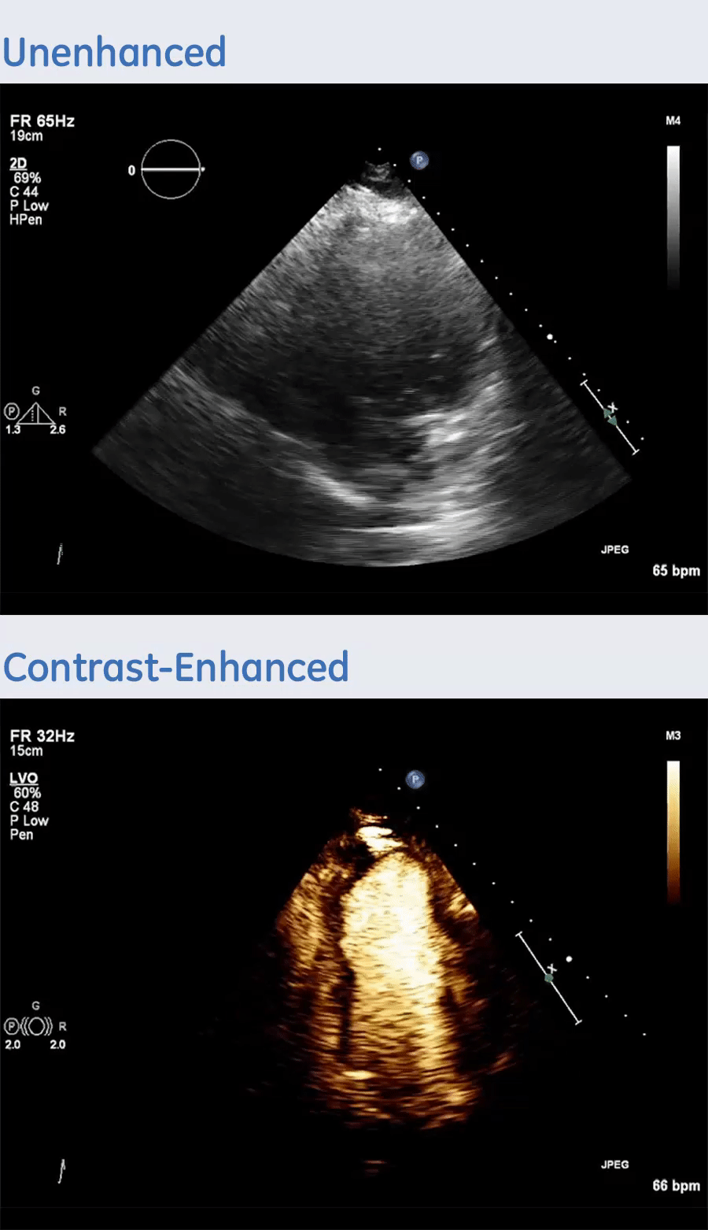
Pharmacokinetics
Nonenhanced
Pharmacokinetics
  Perflutren is eliminated through the lungs within 10 minutes, peaking approximately 30-40 seconds after administration¹
  The albumin component is expected to be handled by the normal metabolic routes¹
Optison-enhanced
Please see Important Safety Information, including Boxed Warning, on slide 2, and Full Prescribing Information provided to you at the beginning of this presentation.
Reference: 1. Optison [prescribing information]. Arlington Heights, IL: GE HealthCare. 2025.
Optison is a trademark of GE HealthCare.
Notes:
This set of images shows how clearly Optison, used in the bottom image, delineates the endocardial borders of the left ventricle which weren’t clearly visualized in the unenhanced upper image.
Optison enhancement lasts up to five minutes if you use a 5.0 mL dose.
As mentioned earlier, the perflutren is expelled through the lungs within 10 minutes, peaking approximately 30-40 seconds after administration.
The albumin component is expected to be handled by the normal metabolic routes.

Slide 13
Safety profile
WARNING: SERIOUS CARDIOPULMONARY REACTIONS Serious cardiopulmonary reactions, including fatalities, have occurred uncommonly during or following perflutren-containing microsphere administration. Most serious reactions occur within 30 minutes of administration Assess all patients for the presence of any condition that precludes OPTISON administration Always have resuscitation equipment and trained personnel readily available
Please see additional Important Safety Information, including Boxed Warning, on slide 2, and Full Prescribing Information provided to you at the beginning of this presentation.
Notes:
Let’s talk about the safety profile of Optison.

Slide 14
Safety
Optison has a well-established safety profile with over 20 years of clinical use across multiple care settings
Most common AEs during treatment with Optison¹
(N=279)
Nausea and/or vomiting
4.3%
Warm sensation or flushing
4.3%
Headache
5.4%
Dizziness
2.5%
<0.5% of patients who received Optison reported back pain as an AE¹
IMPORTANT SAFETY INFORMATION ABOUT OPTISON
WARNINGS AND PRECAUTIONS: Serious cardiopulmonary reactions including fatalities have occurred uncommonly during or shortly following perflutren-containing microsphere administration, typically within 30 minutes of administration. The risk for these reactions may be increased among patients with unstable cardio-pulmonary conditions (acute myocardial infarction, acute coronary artery syndromes, worsening or unstable congestive heart failure, or serious ventricular arrhythmias).
Please see additional Important Safety Information, including Boxed Warning, on slide 2, and Full Prescribing Information provided to you at the beginning of this presentation.
Reference: 1. Optison [prescribing information]. Arlington Heights, IL: GE HealthCare. 2025.
Optison is a trademark of GE HealthCare.
Notes:
With over 20 years of clinical use across multiple care settings, Optison has a very well-established safety profile.
The most common adverse events are headache, nausea and/or vomiting, warm sensation or flushing, and dizziness. Back pain is extremely rare using Optison.
Less than 0.5% of patients who received Optison reported that as an adverse event.

Slide 15



Safety
Optison’s safety profile is supported by multiple post-marketing clinical trials
No clinically important
pulmonary hemodynamic effects
in patients with normal or
elevated baseline PASP¹
(N=30)
No increase in mortality
in critically ill patients administered
Optison vs control patients²
(N=2,900)
No serious AEs and deaths
in >1000 patients administered
Optison in routine clinical practice³
(N=1,039)
IMPORTANT SAFETY INFORMATION ABOUT OPTISON
WARNINGS AND PRECAUTIONS: Serious cardiopulmonary reactions including fatalities have occurred uncommonly during or shortly following perflutren-containing microsphere administration, typically within 30 minutes of administration. The risk for these reactions may be increased among patients with unstable cardio-pulmonary conditions (acute myocardial infarction, acute coronary artery syndromes, worsening or unstable congestive heart failure, or serious ventricular arrhythmias).
Please see additional Important Safety Information, including Boxed Warning, on slide 2, and Full Prescribing Information provided to you at the beginning of this presentation.
References: 1. Main ML, Grayburn PA, Lang RM, et al. Effect of Optison on pulmonary artery systolic pressure and pulmonary vascular resistance. Am J Cardiol. 2013;112(10):1657-1661.
2. Exuzides A, Main ML, Colby C, Grayburn PA, Feinstein SB, Goldman JH. A retrospective comparison of mortality in critically ill hospitalized patients undergoing echocardiography with and without an ultrasound contrast agent. JACC Cardiovasc Imaging. 2010;3(6): 578-585. 3. Wei K, Shah S, Jaber WA, DeMaria A. An observational study of the occurrence of serious adverse reactions among patients who receive optison in routine medical practice. J Am Soc Echocardiogr. 2014;27(9):1006-1010.
Optison is a trademark of GE HealthCare.
Notes:
Multiple post-marketing clinical trials support Optison’s well-established safety profile.
In a study of over 1,000 patients in routine clinical practice there were no serious adverse events or deaths.
A study of nearly 3,000 critically ill patients showed no increase in mortality in patients administered Optison compared to control patients.
And another study found no clinically important pulmonary hemodynamic effects in patients with normal or elevated baseline pulmonary artery systolic pressure.
You can count on Optison’s well-established safety profile.

Slide 16
Optison is the only polyethylene glycol (PEG)-free UEA available in the US
The FDA notified healthcare providers in 2021 that ultrasound enhancing agents (UEAs) containing PEG should not be administered to patients with known or suspected PEG hypersensitivity. This was due to hypersensitivity reactions, including 11 cases of anaphylaxis and 2 deaths, which appear to be linked to the administration of UEAs containing PEG.^{1,2}
Three of the four available UEAs contain PEG—but Optison is PEG-free.
How can Optison help you and your patients?
Enhance peace of mind: Optison helps alleviate concerns
about PEG allergy, because it does not contain PEG3
Improve workflow efficiencies: Optison helps eliminate added
steps to screen for PEG allergy, because it does not contain PEG
PEG
IMPORTANT SAFETY INFORMATION ABOUT OPTISON
CONTRAINDICATION: OPTISON is contraindicated in patients with known or suspected hypersensitivity to perflutren or albumin.
Please see additional Important Safety Information, including Boxed Warning, on slide 2, and Full Prescribing Information provided to you at the beginning of this presentation.
References: 1. FDA Warns Against Some Ultrasound Contrast Agents in Patients with PEG Allergy. American College of Radiology (ACR). https://www.acr.org/Advocacy-and-Economics/Advocacy-News/Advocacy-News-Issues/In-the-April-24-2021-Issue/FDA-Warns-Against-Some-Ultrasound-Contrast-Agents. Published 2022. Accessed January 12, 2023.
2. Lindner JR, Belcik T, Main ML, et al. Expert Consensus Statement from the American Society of Echocardiography on Hypersensitivity Reactions to Ultrasound Enhancing Agents in Patients with Allergy to Polyethylene Glycol (Peg). American Society of Echocardiography. https://www.asecho.org/wp-content/uploads/2021/05/ASE-2526_FDA-EDC-Document_p5.pdf. Published April 2021. Accessed January 12, 2023. 3. Optison Prescribing Information. GE HealthCare. https://www.gehealthcare.com/-/jssmedia/gehc/us/files/products/contrast-media/optison/optison-pi_03-2021_1199798-bk.pdf. Published 2022. Accessed January 12, 2023.
Optison is a trademark of GE HealthCare.
Notes:
Have you heard about polyethylene glycol, or PEG?
It’s used in many different products including some pharmaceuticals, but it may be associated with potentially life-threatening hypersensitivity reactions.
Optison is the only PEG-free UEA available in the US.
Using Optison can help give you and your patients peace of mind, and help improve workflow efficiencies by eliminating additional screening steps because it does not contain PEG.

Slide 17
The FDA Adverse Event (AE) Reporting System
The FDA Adverse Event Reporting System (FAERS)¹
A database that contains adverse event reports, medication error reports, and product quality complaints resulting in adverse events that were submitted to the FDA by healthcare professionals, consumers and manufacturers
    Data quality: There are many instances of duplicative reports, and some reports do not contain all the necessary information
    Existence of a report does not establish causation: For any given report, there is no certainty that a suspected drug caused the reaction
    Information in reports has not been verified: Submission of a report does not mean that the information included in it has been medically confirmed
    nor it is an admission from the reporter that the drug caused or contributed the event
    Rates of occurrence cannot be established with reports: The number of suspected reactions in FAERS should not be used to determine the likelihood
    of a side effect occurring because the FDA does not receive reports for every adverse event or medication error that occurs with a product
IMPORTANT SAFETY INFORMATION ABOUT OPTISON
ADVERSE REACTIONS — Common adverse reactions (incidence > 0.5%) were: headache, nausea and/or vomiting, warm sensation or flushing, dizziness, dysgeusia, chills or fever, flu-like symptoms, malaise/weakness/fatigue, chest pain, dyspnea, injection site discomfort, and erythema. Cardiac arrests and other serious but nonfatal adverse reactions were uncommonly reported in post-approval use. Reports also identified neurologic reactions (loss of consciousness or convulsions) as well as anaphylactoid reactions. Overall, the safety profile observed in pediatric patients from the clinical study was consistent with the safety profile in adult patients.
Please see additional Important Safety Information, including Boxed Warning, on slide 2, and Full Prescribing Information provided to you at the beginning of this presentation.
References: 1. U.S. FDA Website. Questions and Answers on FDA’s Adverse Event Reporting System (FAERS). https://www.fda.gov/drugs/guidancecomplianceregulatoryinformation/surveillance/adversedrugeffects/default.htm. Accessed September 2, 2022.
Optison is a trademark of GE HealthCare.
Notes:
If you go to the FDA Adverse Event Reporting System online, you can see the adverse events of all agents.
The database contains adverse event reports but also medication errors as well as product quality complaints—so it includes a very wide range within that category of adverse events.
But once again in six years, only 41 adverse events were reported in the United States.
The database does not include adverse events that were not reported to the FDA.
The actual number of adverse events is unknown, though it’s typically thought that only a fraction of adverse events is reported by consumers and healthcare providers.
Per the FDA the data cannot be used to calculate the incidence of an adverse event or medication error in the US population, nor are the data by themselves an indicator of the safety profile of the drug.

Slide 18
Image quality and case study
Notes:
Now let’s talk about image quality and review a patient case in which Optison was used.

Slide 19



Case study
67-year-old male presented with hypertension, type 2 diabetes mellitus, and obesity*
Blood pressure
N/A
Due to poor LV endocardial border definition, ultrasound contrast (Optison) was used
After injection of Optison, the patient with suboptimal echocardiograms showed improved delineation of the
LV endocardial borders
*Actual patient
Height
6'1"
Weight
297 lbs
IMPORTANT SAFETY INFORMATION ABOUT OPTISON
Contraindications: OPTISON is contraindicated in patients with known or suspected hypersensitivity to perflutren or albumin.
Please see additional Important Safety Information, including Boxed Warning, on slide 2, and Full Prescribing Information provided to you at the beginning of this presentation.
Optison is a trademark of GE HealthCare.
Notes:
This actual patient case study is a 67-year-old male who presented with hypertension, type 2 diabetes as well as obesity.
He is 6’1” and weighs almost 300 pounds.
Due to poor left ventricular endocardial border definition, Optison was used.

Slide 20
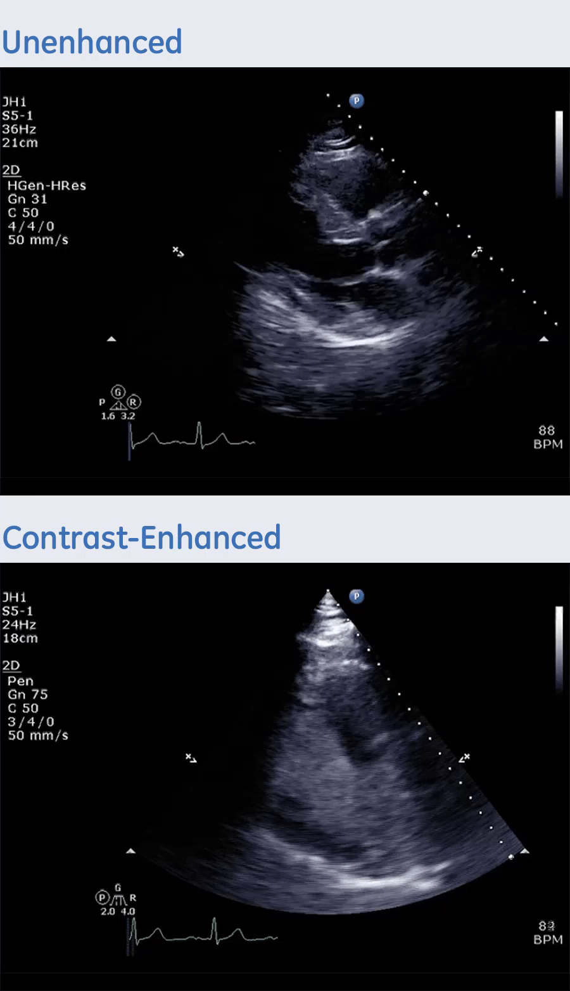
Actual patient
PLAX, Parasternal long axis
Nonenhanced
Please see Important Safety Information, including Boxed Warning, on slide 2, and Full Prescribing Information provided to you at the beginning of this presentation.
Optison is a trademark of GE HealthCare.
Notes:
Here is the unenhanced parasternal long axis view.
Can you clearly see all segments?

Slide 21
Actual patient
PLAX, Parasternal long axis
Nonenhanced
Optison-enhanced
Please see Important Safety Information, including Boxed Warning, on slide 2, and Full Prescribing Information provided to you at the beginning of this presentation.
Optison is a trademark of GE HealthCare.
Notes:
Do you see anything additional with the Optison-enhanced image?

Slide 22
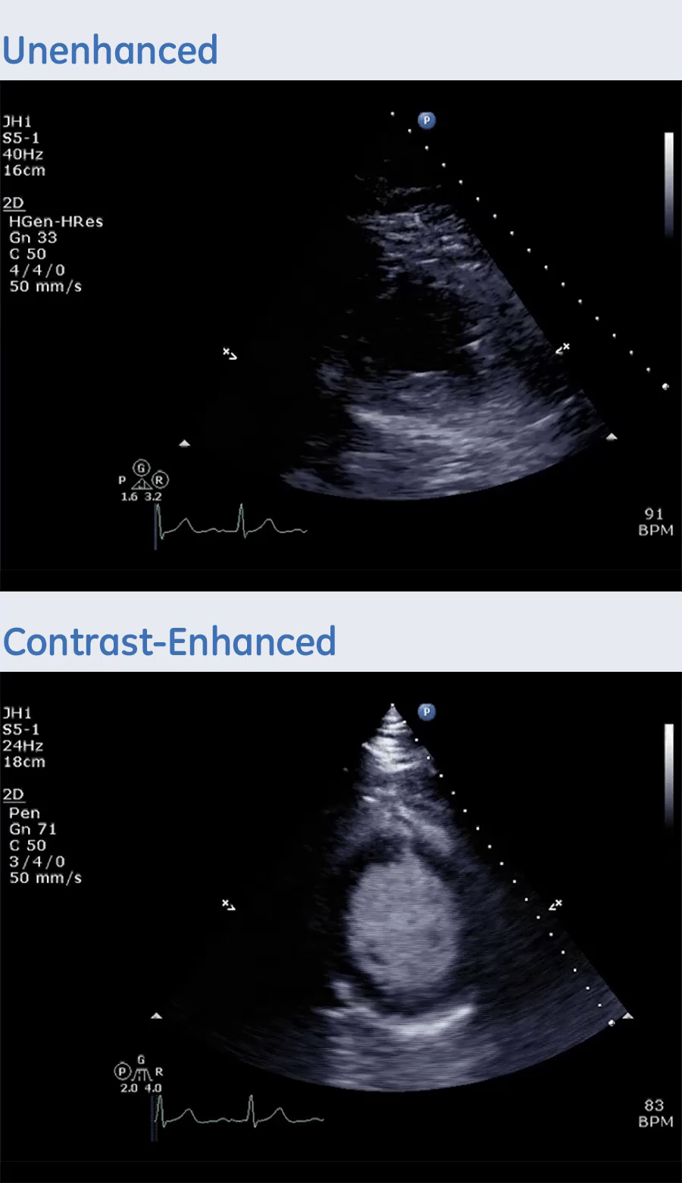
Actual patient
PSAX, Parasternal short axis
Nonenhanced
Please see Important Safety Information, including Boxed Warning, on slide 2, and Full Prescribing Information provided to you at the beginning of this presentation.
Optison is a trademark of GE HealthCare.
Notes:
Here is the patient’s parasternal short axis view.

Slide 23
Actual patient
PSAX, Parasternal short axis
Nonenhanced
Optison-enhanced
Please see Important Safety Information, including Boxed Warning, on slide 2, and Full Prescribing Information provided to you at the beginning of this presentation.
Optison is a trademark of GE HealthCare.
Notes:
In comparison you can see the clear endocardial border definition with the Optison-enhanced image.

Slide 24
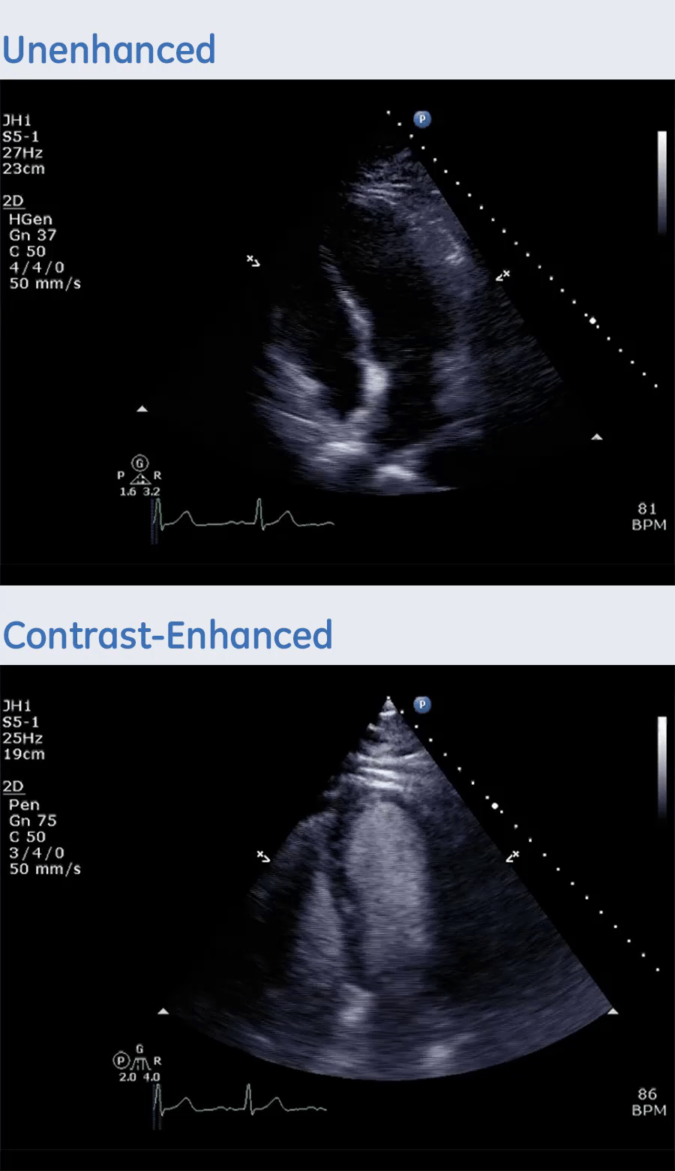
Actual patient
A4CH, Apical 4 Chamber View
Nonenhanced
Please see Important Safety Information, including Boxed Warning, on slide 2, and Full Prescribing Information provided to you at the beginning of this presentation.
Optison is a trademark of GE HealthCare.
Notes:
Here is the apical 4 chamber view.

Slide 25
Actual patient
A4CH, Apical 4 Chamber View
Nonenhanced
Optison-enhanced
Please see Important Safety Information, including Boxed Warning, on slide 2, and Full Prescribing Information provided to you at the beginning of this presentation.
Optison is a trademark of GE HealthCare.
Notes:
In the Optison-enhanced image there is clear definition of the endocardial border.
You can see eight segments all the way from the basal wall to the apex, and all the way down the lateral side providing complete opacification of left ventricle.

Slide 26
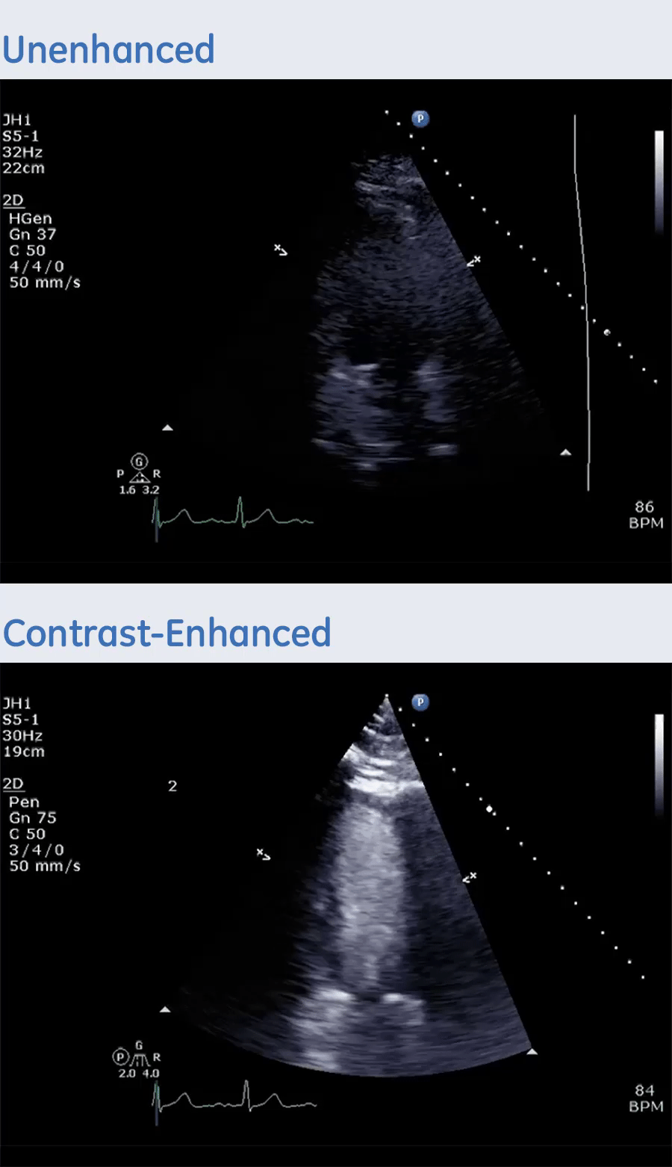
Actual patient
A2CH, Apical 2 Chamber View
Nonenhanced
Please see Important Safety Information, including Boxed Warning, on slide 2, and Full Prescribing Information provided to you at the beginning of this presentation.
Optison is a trademark of GE HealthCare.
Notes:
Here is the apical 2 chamber view.

Slide 27
Actual patient
A2CH, Apical 2 Chamber View
Nonenhanced
Optison-enhanced
Please see Important Safety Information, including Boxed Warning, on slide 2, and Full Prescribing Information provided to you at the beginning of this presentation.
Optison is a trademark of GE HealthCare.
Notes:
Can you see anything more with the Optison enhancement?

Slide 28
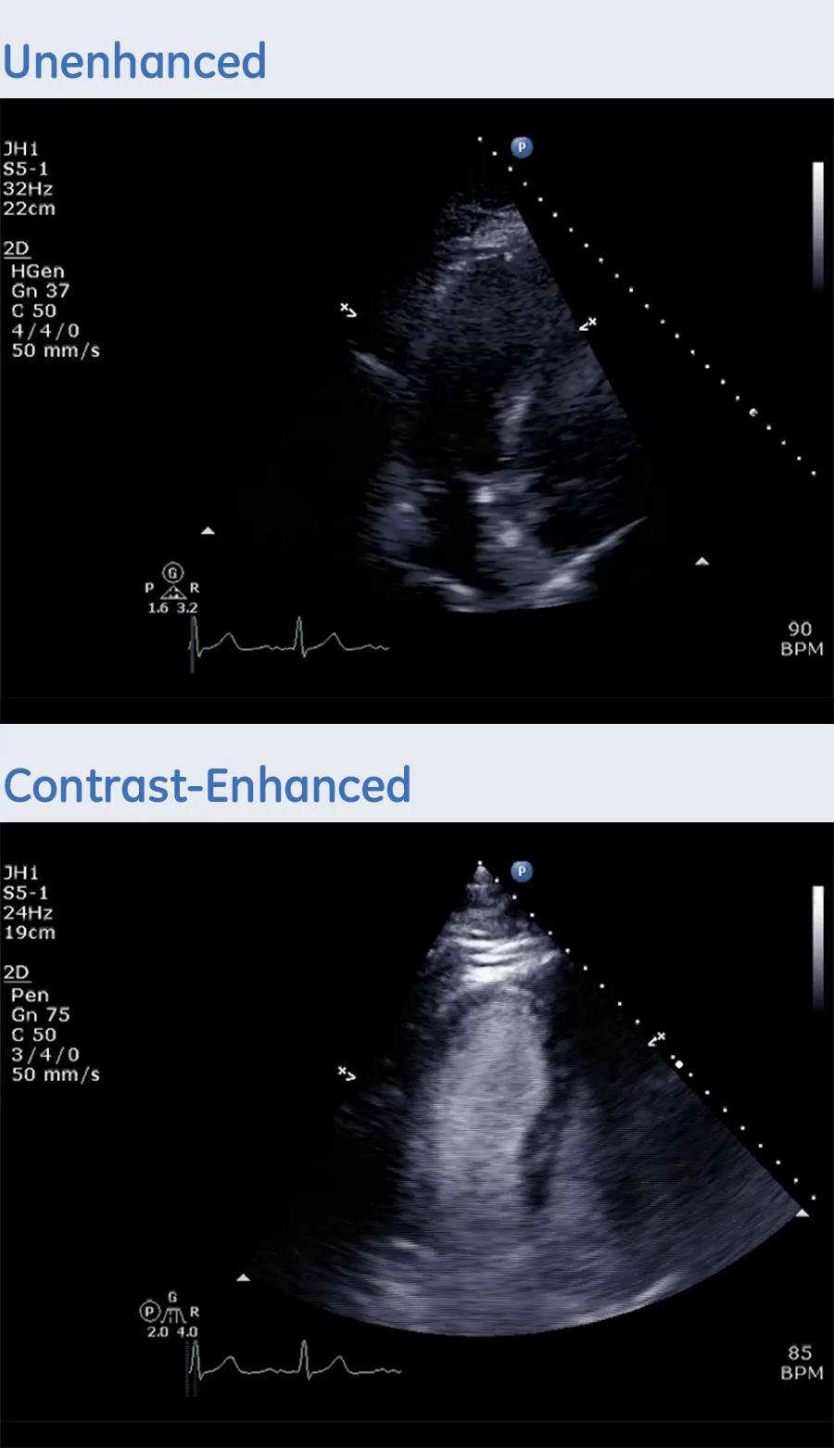
Actual patient
A3CH, Apical 3 Chamber View
Nonenhanced
Please see Important Safety Information, including Boxed Warning, on slide 2, and Full Prescribing Information provided to you at the beginning of this presentation.
Optison is a trademark of GE HealthCare.
Notes:
And for the final view we have the apical 3 chamber.

Slide 29
Actual patient
A3CH, Apical 3 Chamber View
Nonenhanced
Optison-enhanced
Please see Important Safety Information, including Boxed Warning, on slide 2, and Full Prescribing Information provided to you at the beginning of this presentation.
Optison is a trademark of GE HealthCare.
Notes:
What do you notice now that you see it enhanced by Optison?
Optison can help provide a clear path forward by helping to improve image quality.

Slide 30
Ultrasound enhancing agent (UEA) Guidelines
Notes:
Let's talk about the guidelines for using ultrasound enhancing agents.

Slide 31


Ultrasound Enhancing Agent (UEA) guidelines
ASE Guidelines
IAC Standards
With UEAs, suboptimal echocardiograms
(i.e., nonvisualization of at least two or more segments)
can be converted to a useful examination.¹
The 2025 Intersocietal Accreditation Commission (IAC) Standaards recommend a UEA when two or more LV segments cannot be visualized adequately for the assessment of LV function (LVEF and regional wall motion assessment) and/or in settings in which the study indication requires accurate analysis of regional wall motion.²
Please see Important Safety Information, including Boxed Warning, on slide 2, and Full Prescribing Information provided to you at the beginning of this presentation.
References: 1. Porter TR, Mulvagh SL, Abdelmoneim SS, et al. Clinical applications of ultrasonic enhancing agents in echocardiography: 2018 American Society of Echocardiography Guidelines Update. J Am Soc Echocardiogr. 2018;31:241-247. 2. https://intersocietal.org/wp-content/uploads/2025/08/IACAdultEchocardiographyStandards2025.pdf Accessed September 25, 2025
Optison is a trademark of GE HealthCare.
Notes:
The American Society of Echocardiology (or ASE) established guidelines for what is considered a technically difficult study.
When there is nonvisualization of at least two or more segments it’s considered a suboptimal echocardiogram.
Ultrasound enhancing agents (or UEAs) can help convert suboptimal echocardiograms into diagnostic examinations.
The Intersocietal Accreditation Commission (IAC) 2018 standards recommend using a UEA when there is nonvisualization of any three of the apical views as it provides greater accuracy in determining left ventricular function.

Slide 32
Suboptimal echocardiograms can be resolved using a UEA¹ and it increases the likelihood of a diagnostic scan in:
~10%-15% of routine echocardiograms²
~25%-30% of echocardiograms performed in the ICU³
Suboptimal echocardiograms can be changed to diagnostic images in ~75%-90% of patients using ultrasound contrast⁴
Please see Important Safety Information, including Boxed Warning, on slide 2, and Full Prescribing Information provided to you at the beginning of this presentation.
References: 1. Cohen JL et al. J Am Coll Cardiol. 1998;32:746-752. 2. Senior R et al. Eur J Echocardiogr. 2005;6 Suppl 2:S6-S13. 3. Kurt M et al. J Am Coll Cardiol. 2009;53:802-810. 4. Mulvagh SL et al. J Am Soc Echocardiogr. 2008;21:1179-1201.
Optison is a trademark of GE HealthCare.
Notes:
Multiple studies show that incomplete endocardial resolution occurs in approximately 10-15% of routine echocardiograms, and approximately 25-30% of studies in the ICU.
Using a UEA for suboptimal echos increases the likelihood of a diagnostic scan.
According to ASE’s 2008 consensus statement, suboptimal echocardiograms can be changed to diagnostic images in approximately 75-90% of patients using a UEA.

Slide 33
Efficiency
Notes:
So let’s discuss a little bit about efficiency with Optison.

Slide 34




Optison has the potential to integrate seamlessly into your workflow
Prepare
Invert and rotate Optison vial to prepare; no shaking or assembly time required
Check
Inspect the vial for complete resuspension*
Do not use Optison if, after resuspension, the solution appears to be clear rather than opaque milky-white
Load syringe
Vent vial with sterile vent spike or 18-gauge needle; withdraw and prepare to inject
Administer within 60 seconds of suspension
*Failure to adequately resuspend Optison may cause an underdelivery of the microspheres and may result in inadequate contrast.
For bolus injection, Optison takes <1 min from suspension to injection
Optison is for single use only. Follow label instructions for product handling and use and discard unused product properly.
IMPORTANT SAFETY INFORMATION ABOUT OPTISON—Preparation Instructions
Visually inspect the OPTISON vial. Do not use if the container has been damaged, the protective seal and/or rubber cap have been entered, or the upper white layer is absent (may indicate the microspheres have been damaged and may result in poor or no echo contrast).
Invert the vial and gently rotate to resuspend the microspheres. This process will allow the product to come to room temperature (20°C to 25°C or 68°F to 77°F) before use.
Inspect the vial for complete resuspension. Do not use if the suspension appears to be clear rather than opaque and milky-white. Vent the OPTISON vial with a sterile vent spike or with a sterile 18-gauge needle before withdrawing the OPTISONsuspension into the injection syringe.
Do not inject air into the vial.
Use the product within one minute of suspension. If one minute is exceeded, resuspend by inverting and gently rotating the syringe for no less than 10 seconds. Failure to adequately resuspend OPTISON may cause inadequate delivery of the microspheres and may result in inadequate contrast.
Please see additional Important Safety Information, including Boxed Warning, on slide 2, and Full Prescribing Information provided to you at the beginning of this presentation.
Reference: 1. Optison [prescribing information]. Arlington Heights, IL: GE HealthCare; 2025.
Optison is a trademark of GE HealthCare.
Notes:
Preparation of Optison is very efficient; simply invert and rotate the vial for about 10 seconds – no shaking or assembly time is required.
Check the vial for complete resuspension—it should be completely opaque or milky white.
Vent the vial with a sterile vent spike or 18-guage needle, withdraw and prepare to administer within 60 seconds of suspension.
For bolus injection, Optison takes less than a minute from suspension to injection.
Resuspend Optison if it’s not used within one minute after resuspension.

Slide 35
Optison administration
Flexible options to help meet your needs
Optison, like other ultrasound enhancing agents (UEAs), is administered in everyday clinical practice in a variety of ways¹⁻⁶
BOLUS
DILUTED BOLUS
IMPORTANT SAFETY INFORMATION ABOUT OPTISON
Use Optison within one minute of suspension or, if sitting longer, resuspend before use following package insert directions. Do not use the single patient use vial for more than one patient. Administer Optison intravenously. Do not administer intra-arterially.
Please see additional Important Safety Information, including Boxed Warning, on slide 2, and Full Prescribing Information provided to you at the beginning of this presentation.
References: 1. Porter TR, et al. J Am Soc Echocardiogr. 2014;27:797-810. 2. Zhao H et al. J Am Soc Echocardiogr. 2018;31:289-296. 3. Doukky R, et al. Echocardiography. 2018; DOI: 10.1111/echo.14228. 4. Karadogin I, et al. J CV Imaging. 2020;36:431-439. 5. Chong A, et al. Indian Heart Journal. 2013;65:337-346. 6. GE HealthCare data on file.
Optison is a trademark of GE HealthCare.
Notes:
There are flexible options to help meet your needs when it comes to administration.
Optison is administered in everyday clinical practice in a variety of ways including bolus and diluted bolus.

Slide 36
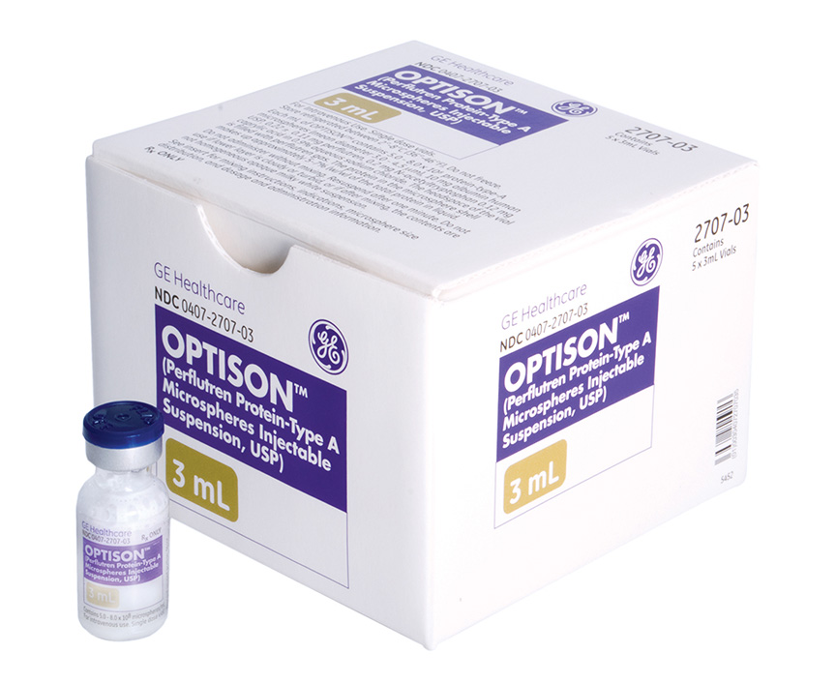



Storage and portability can help department efficiency
Storage
Optison is available in two package sizes containing 5 or 18
Optison 3-mL vials, respectively
Optison is stored in a refrigerator at 2°-8°C
No vial mixer or special equipment required to resuspend
Optison is stable at room temperature for up to 24 hours
If unopened, Optison can be returned safely to the refrigerator
for later use
Please see Important Safety Information, including Boxed Warning, on slide 2, and Full Prescribing Information provided to you at the beginning of this presentation.
Optison is a trademark of GE HealthCare.
Notes:
Storage and portability can help department efficiency as well.
Optison is available in two package sizes containing 5 or 18 Optison 3-mL vials.
It is stored in a refrigerator at 2-8°C and should not be frozen.
There are three key portability and efficiency factors that help set Optison apart:
• No vial mixer or special equipment is required to resuspend Optison
• It is stable at room temperature up to 24 hours
• If it’s unopened, it can be returned safely to the refrigerator for use at a later time

Slide 37

Support
Optison is backed by a team of sonographers, always on hand to offer clinical and commercial support
GE HealthCare offers a dedicated payor account executive team to support with:
Product inquiries
Product trials
CE programs
Formulary kit
Machine settings
Image optimization
Guideline recommendations
Educational programs with insights on policies and procedures
Coding and billing support for Optison
Supporting you in understanding the payor environment
Navigating payor coverage policy questions
Understanding reimbursement differences by setting of care and insurance types
Please see Important Safety Information, including Boxed Warning, on slide 2, and Full Prescribing Information provided to you at the beginning of this presentation.
For medical affairs inquiries, please contact medical information at 800 654 0118 or medical.affairs@gehealthcare.com.
For our reimbursement hotline, please call 800 767 6664.
Optison is a trademark of GE HealthCare.
Notes:
Every UEA is different, and if you haven’t been using a UEA, having the support of a team to help ensure you’re obtaining optimized imaging with Optison is important.
A team of sonographers as well as a dedicated payor account executive team is available to support all of our customers.
GE Healthcare Pharmaceutical diagnostics can provide the following services to meet your needs:
• Answer product inquiries
• Conduct product trials
• Offer CE programs
• Provide the formulary kit
• Fine tune your machine settings
• Optimize your images
• Share society guideline recommendations
• Provide educational programs with insights on policies and procedures
• Coding and billing support
• Supporting you in understanding the payor environment
• Navigating payor coverage policy questions
• Understanding reimbursement differences by setting of care and insurance types
Medical Affairs is always available to answer questions you may have as well.

Slide 38
Thank you! Today we discussed:
  Optison timeline
  Composition
  Mechanism of action
  Safety profile
  Image quality and case study
  Ultrasound enhancing agent (UEA) guidelines
  Efficiency
  Support
Please see Important Safety Information, including Boxed Warning, on slide 2, and Full Prescribing Information provided to you at the beginning of this presentation.
Optison is a trademark of GE HealthCare.
Notes:
So today we discussed the indication of Optison, its composition, as well as mechanism of action.
We walked through Optison’s safety profile.
Then we reviewed a case study to view image quality.
We discussed the guidelines that support the use of ultrasound enhancing agents.
And finally, we reviewed efficiencies associated with using Optison, plus the wide array of clinical, reimbursement and medical support we offer our customers.
I want to thank you for your time and attention. Let’s open it up for questions and answers!

Slide 39
© 2025 GE HealthCare.
Optison is a trademark of GE HealthCare.
GE is a trademark of General Electric Company used under trademark license.
October 2025
JB12577US

